Slide 1
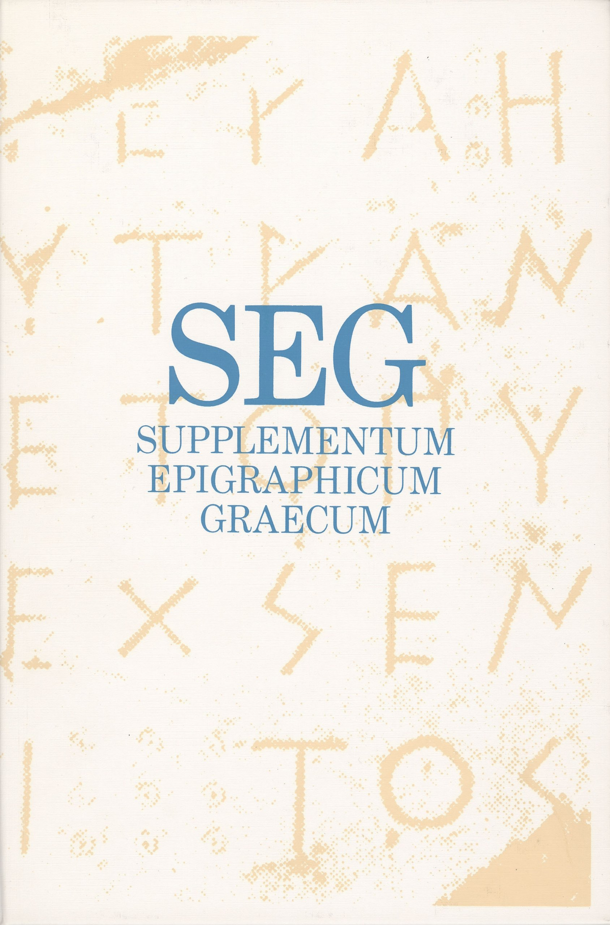
SEG Forward
Project
Lessons learned
Feedback

Slide 2
Goals
Create database
For all SEG volumes
Create API
Modular approach
Create editing environment
For the editors to work in
Create publication environment
Online and print

Slide 3
Current workflow for SEG
.docx
.pdf
print
.docx
.xml
online
Notes:
Note that this XML is Brill proprietary and not according to any standard

Slide 4
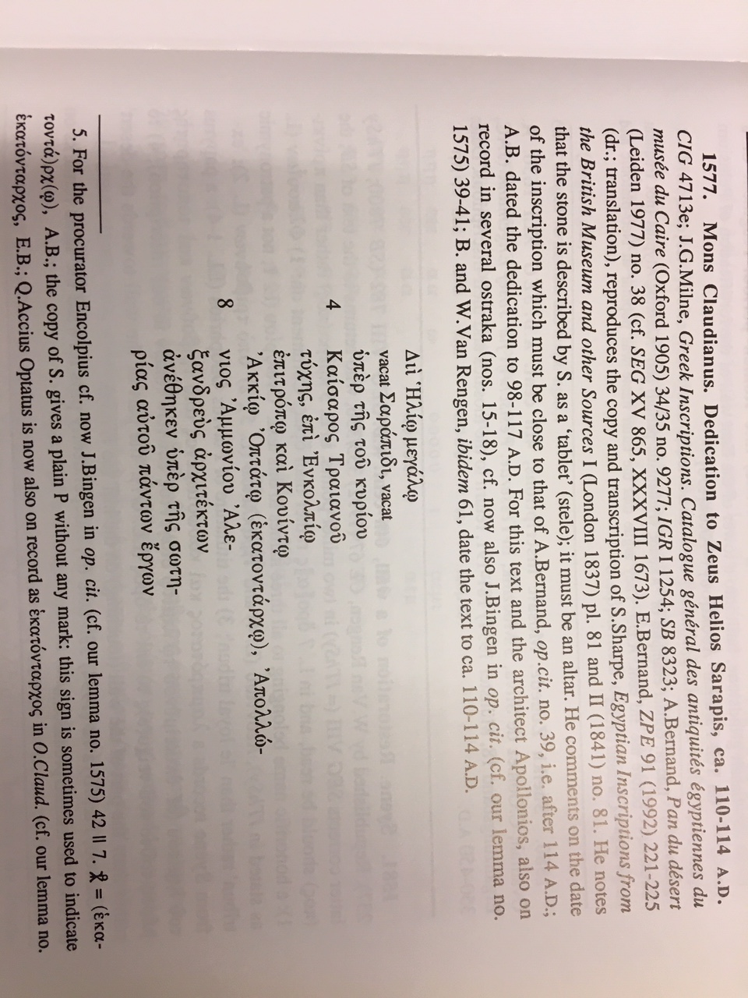
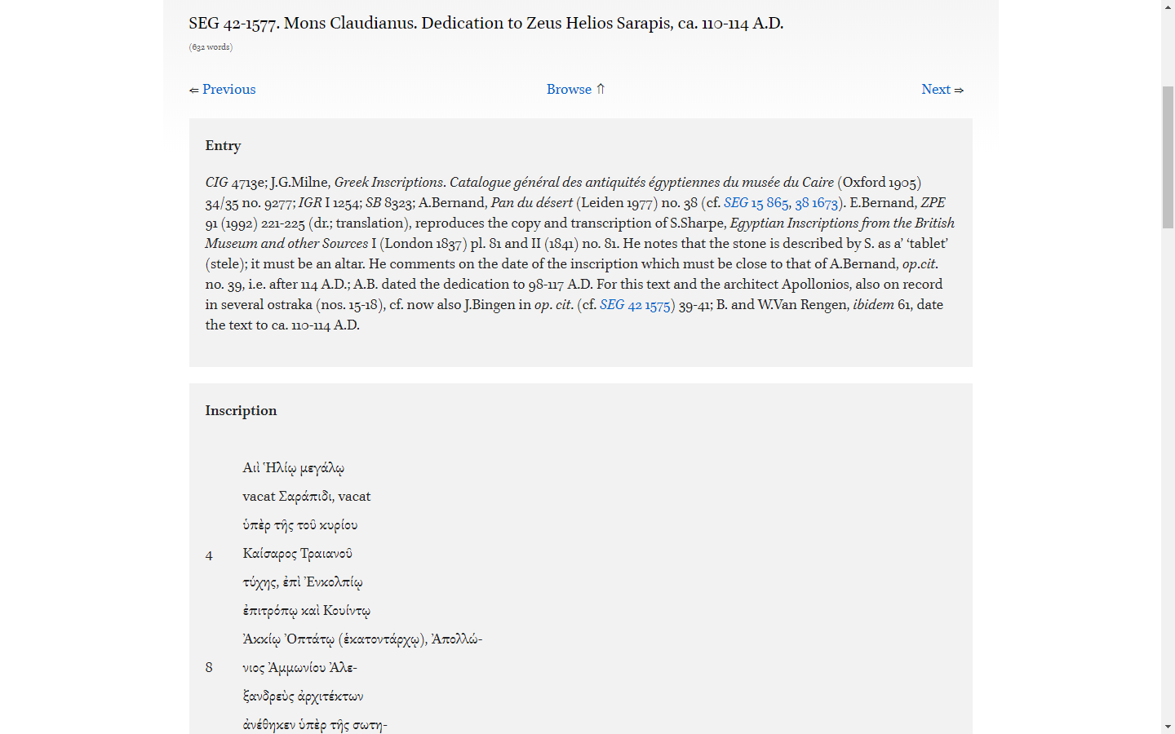
Current publication
Print
Online
Notes:
Note how the online is just like the print, despite efforts of datafication, and doesn’t unlock the richness of SEG.

Slide 5
New workflow for SEG
Editing environment
.pdf
print
.xml
online
Notes:
Note that this XML is Epidoc, hence TEI, hence a standard

Slide 6
Reasons
Save time spent on typesetting
Advantage for editors
Better control over data
Advantage for readers
Save money spent on creating XML
Advantage for Brill
Better website, integration, sustainability
Advantage for everybody

Slide 7
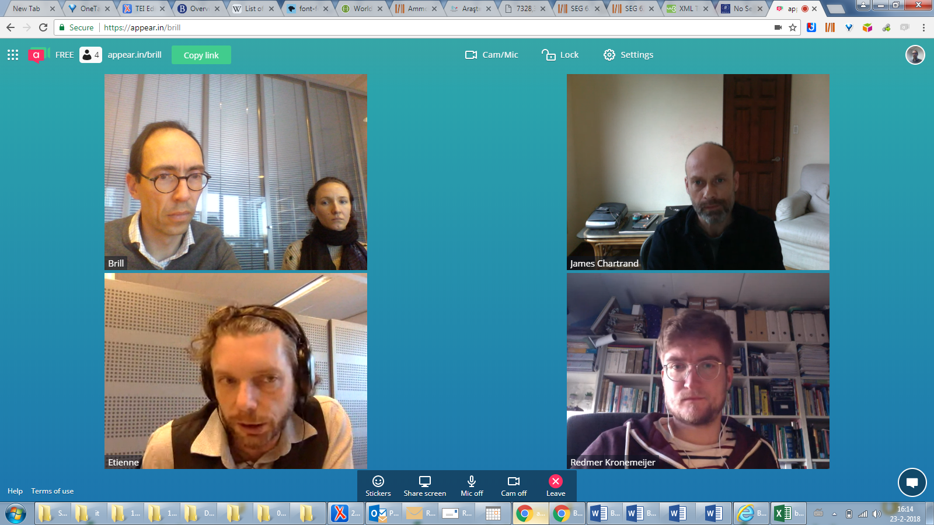
Team

Slide 8
What is SEG?
Bibliography
New readings
Supplement…
To existing corpora
New inscriptions
Commentaries

Slide 9
Data model for SEG
Entry
Reference
Inscription

Slide 10
Data model for SEG (details)
User
Entry
Reference
Place
Inscription
Inscription Type
Index Term
Notes:
Note that these are objects in the SEG database

Slide 11
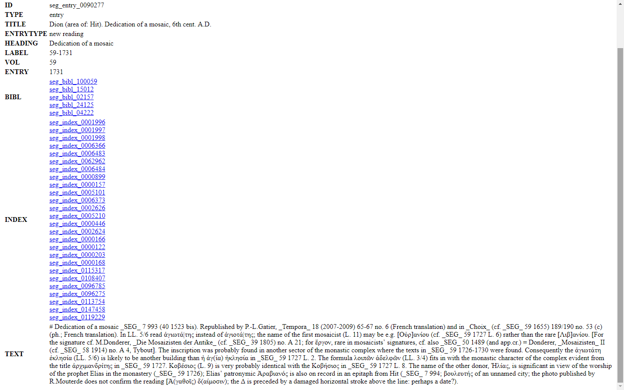
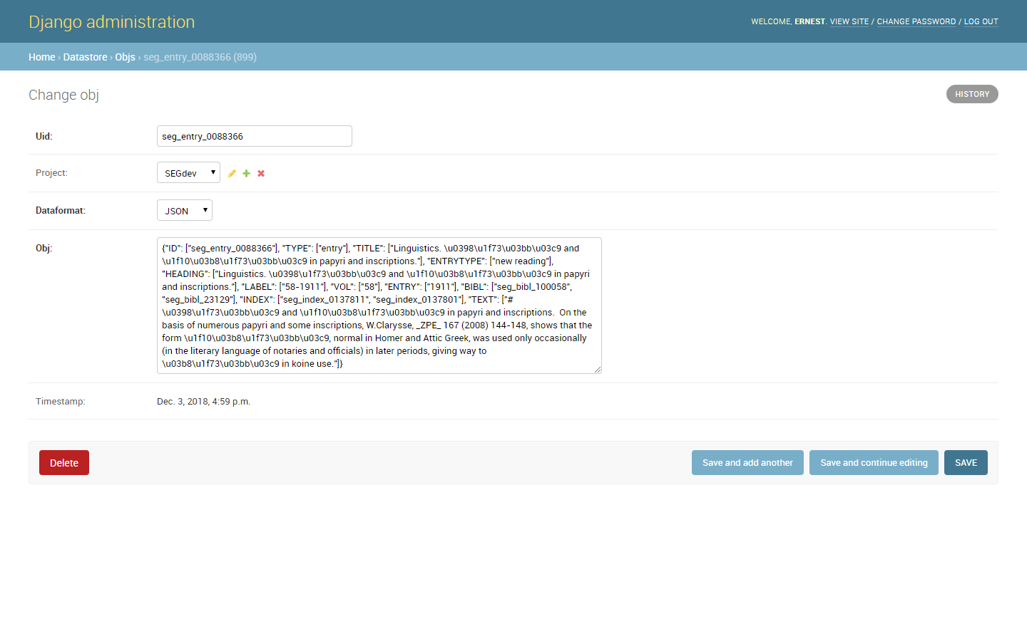
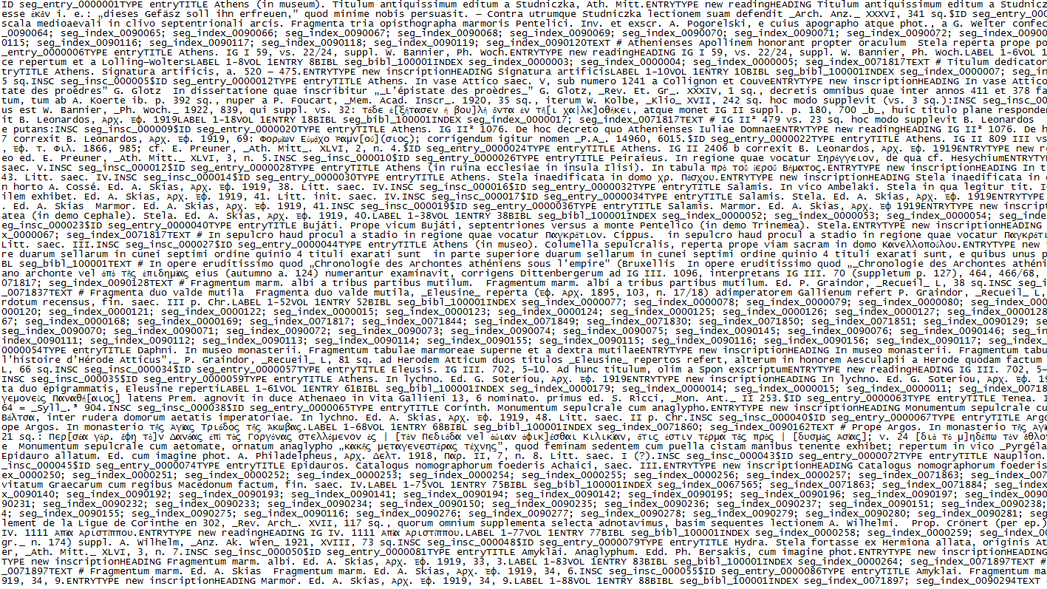
Database
https://data.brill.com/sites/segadmin/raw
https://data.brill.com/admin/datastore/obj/
Notes:
Note that the right is the database: plain text, in a JSON blob. Left is the result of Django template that transforms the blob into HTML. The same mechanism is used to create TEI Epidoc.

Slide 12
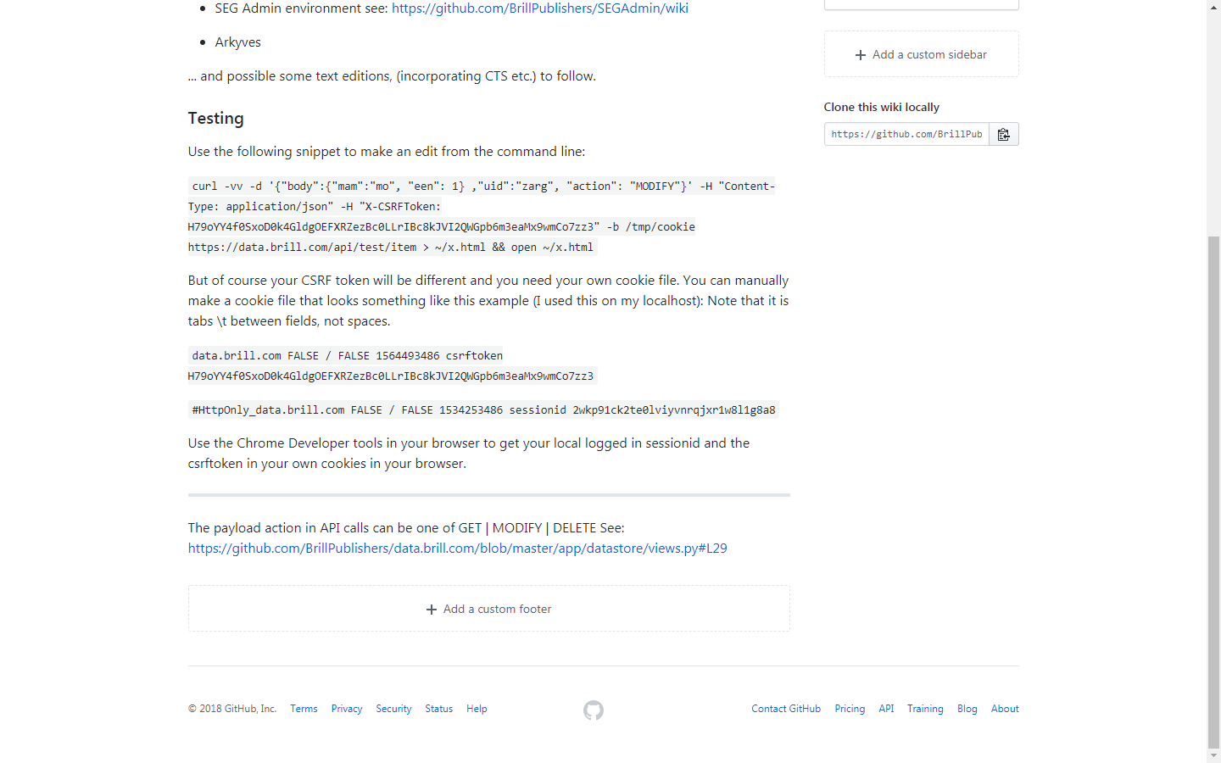
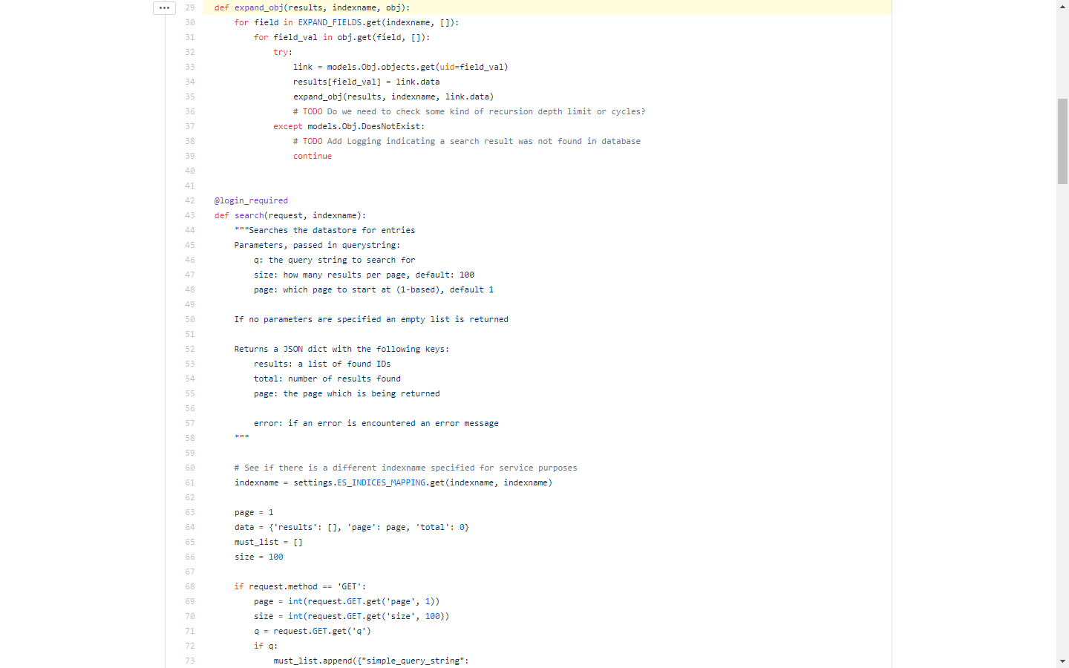
API
Work in progress…

Slide 13
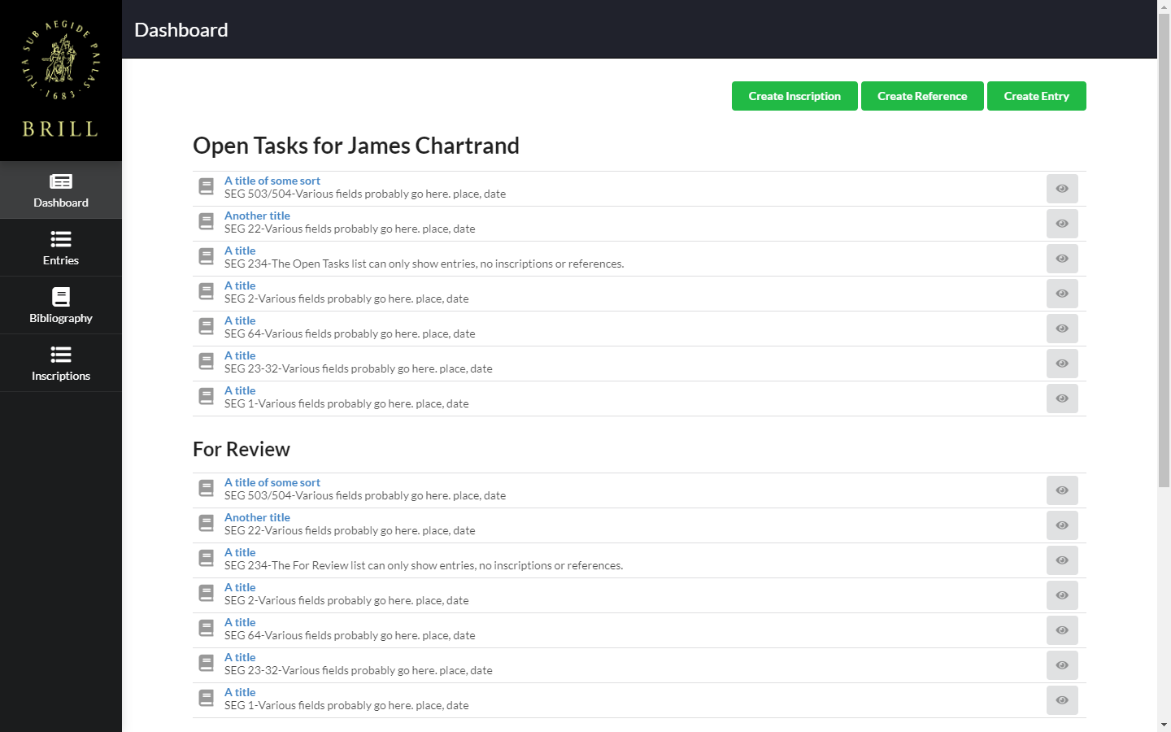
Editing environment (tour)
Notes:
https://data.brill.com/sites/segadmin/

Slide 14
Editing environment (dashboard)

Slide 15
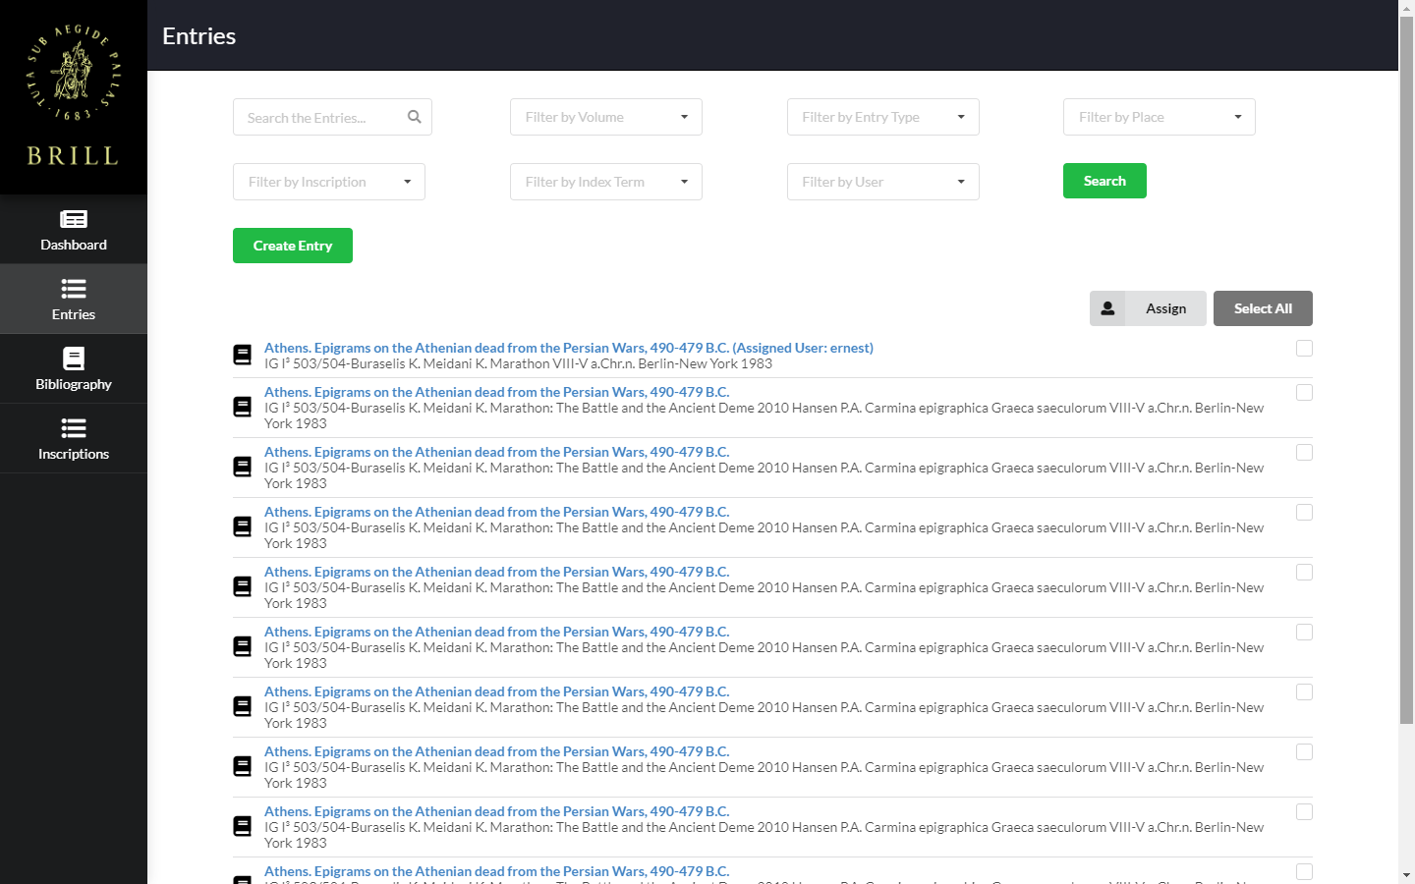
Editing environment (entries)

Slide 16
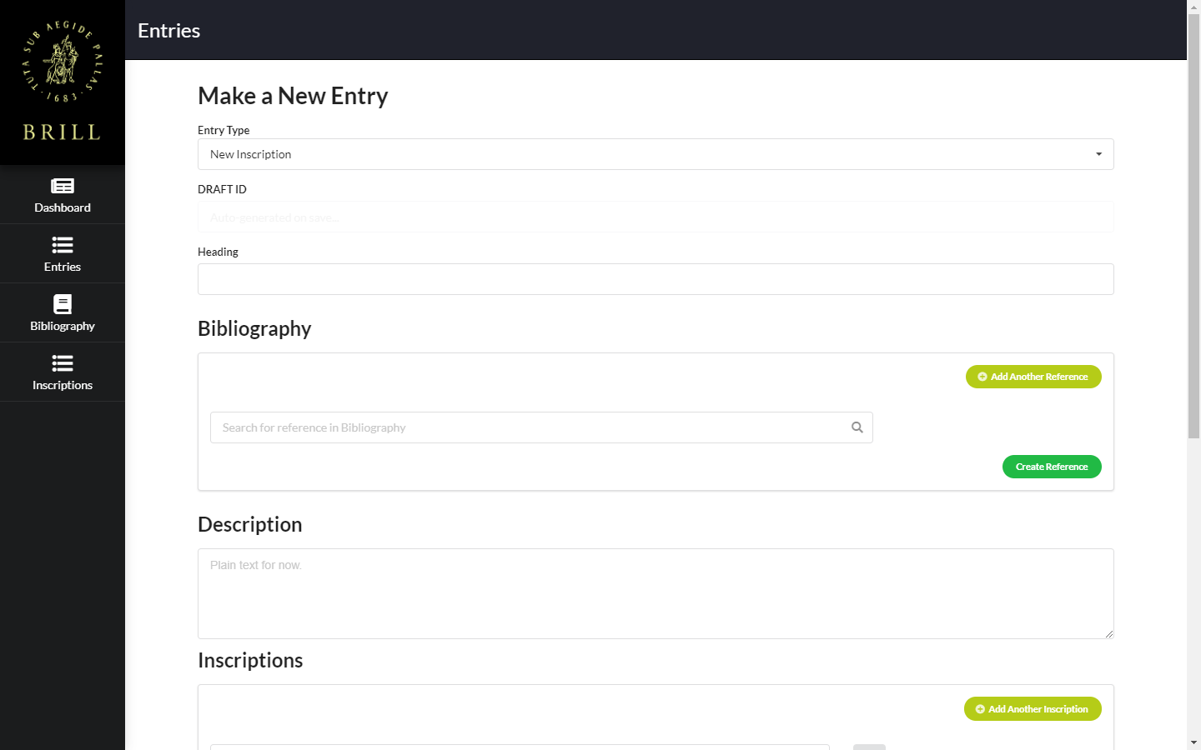
Editing environment (create entry, top)

Slide 17
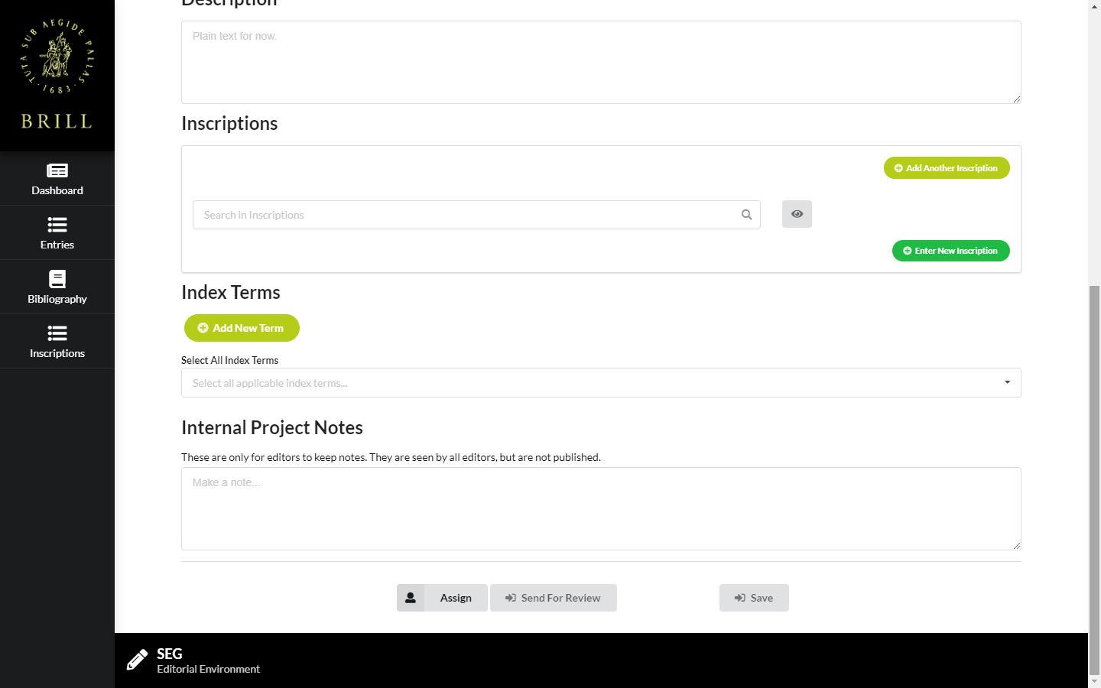
Editing environment (create entry, bottom)

Slide 18
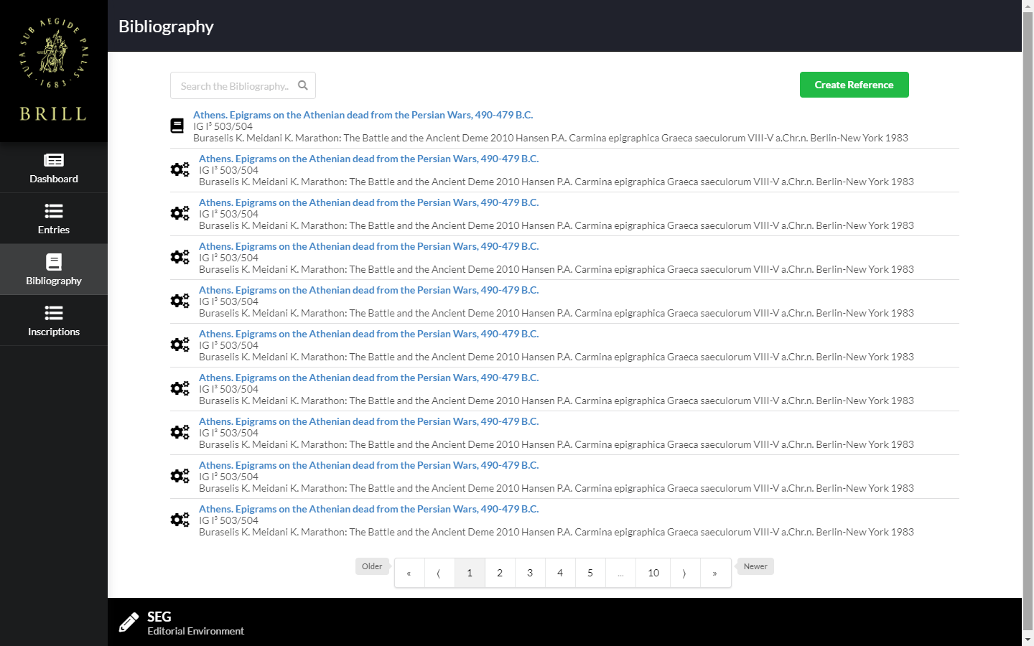
Editing environment (references)

Slide 19
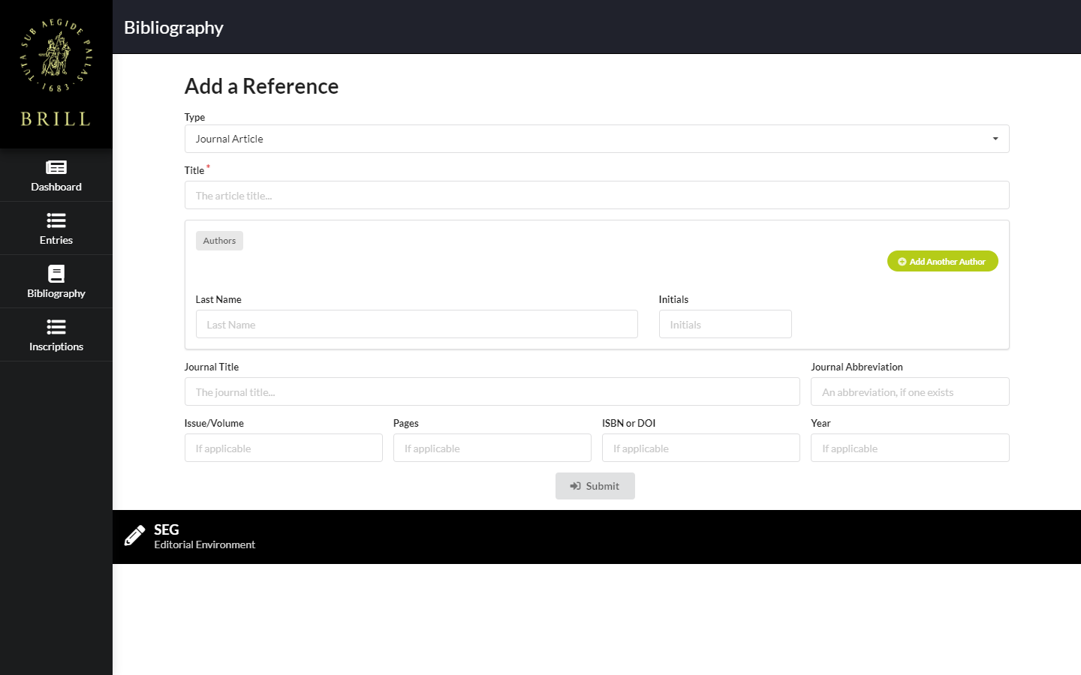
Editing environment (create reference)

Slide 20
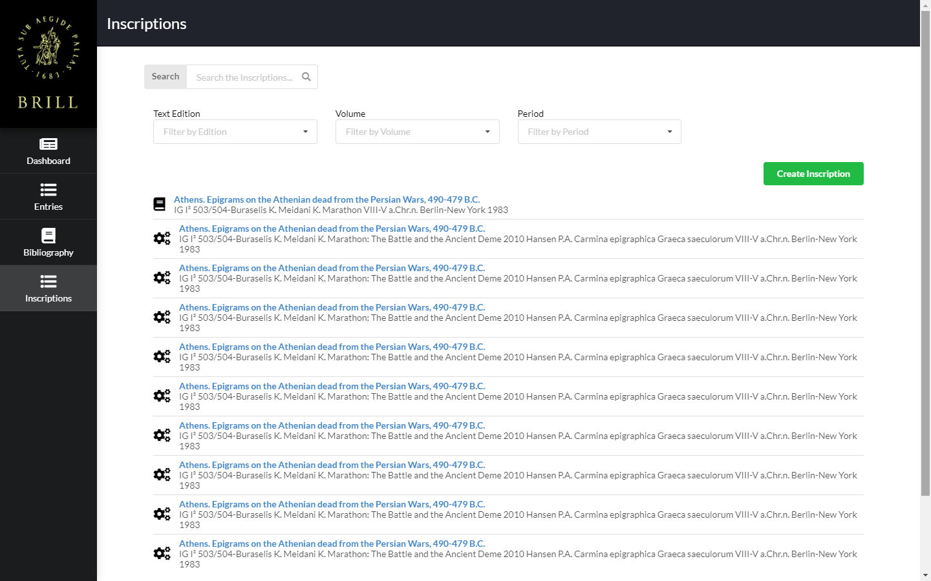
Editing environment (inscriptions)

Slide 21
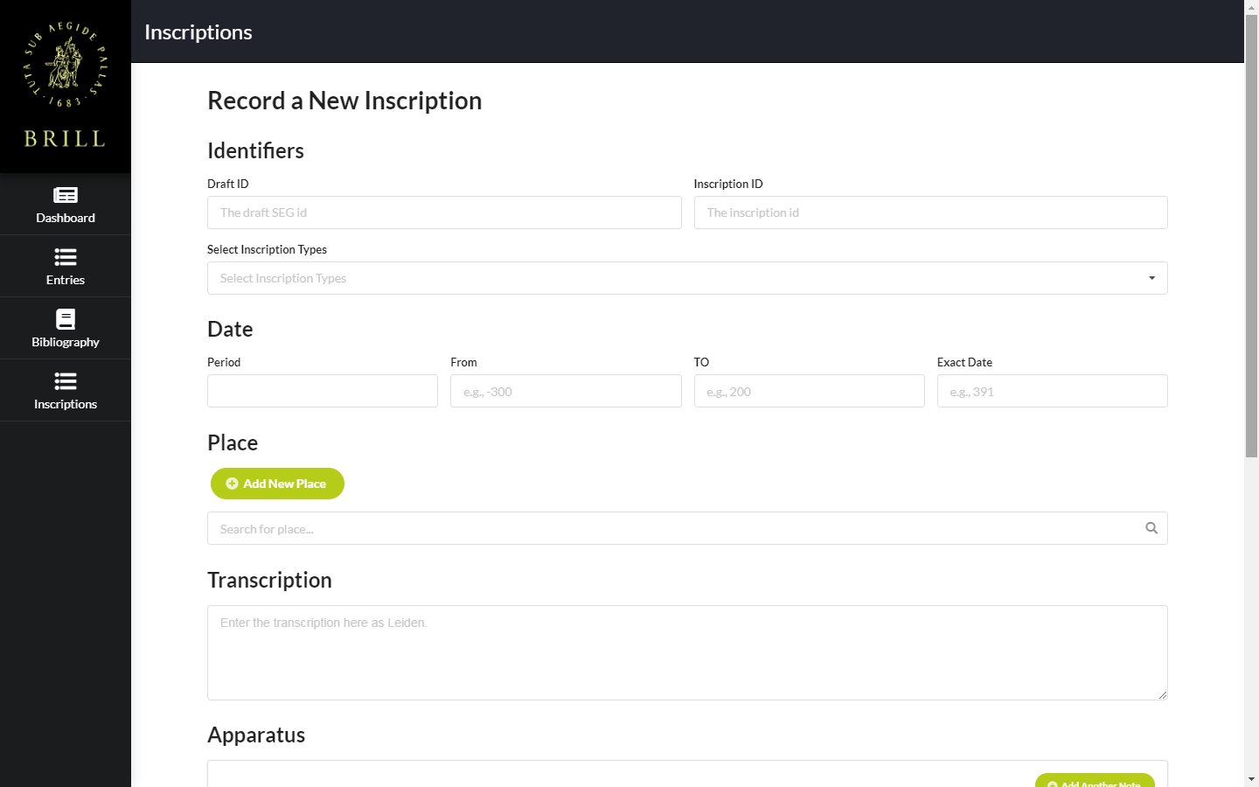
Editing environment (create inscription, top)

Slide 22
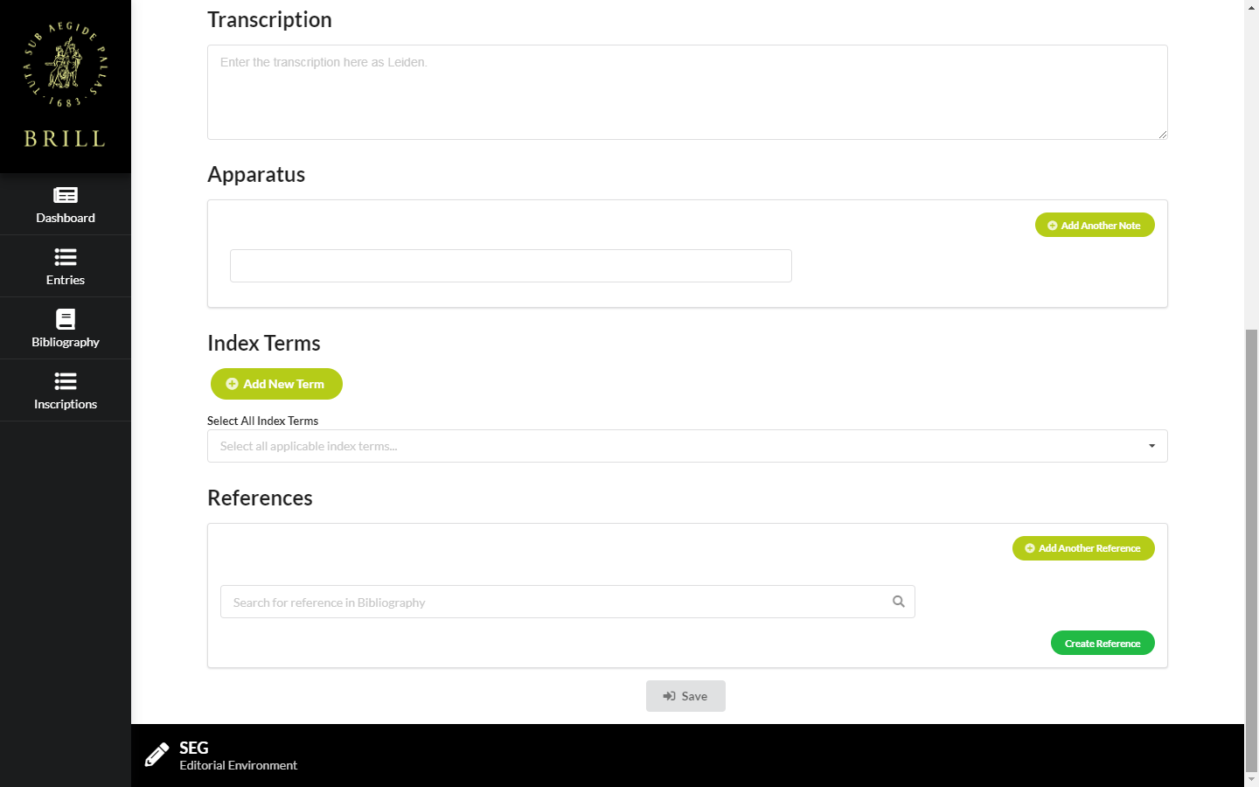
Editing environment (create inscription, bottom)

Slide 23
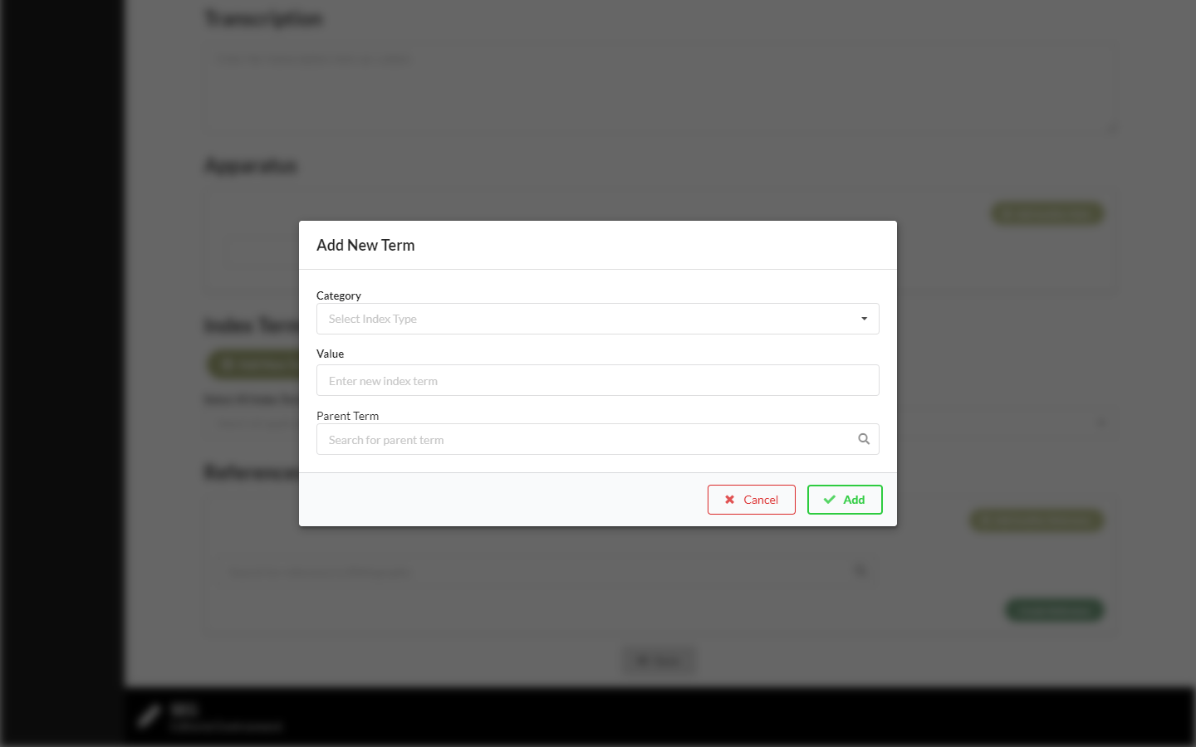
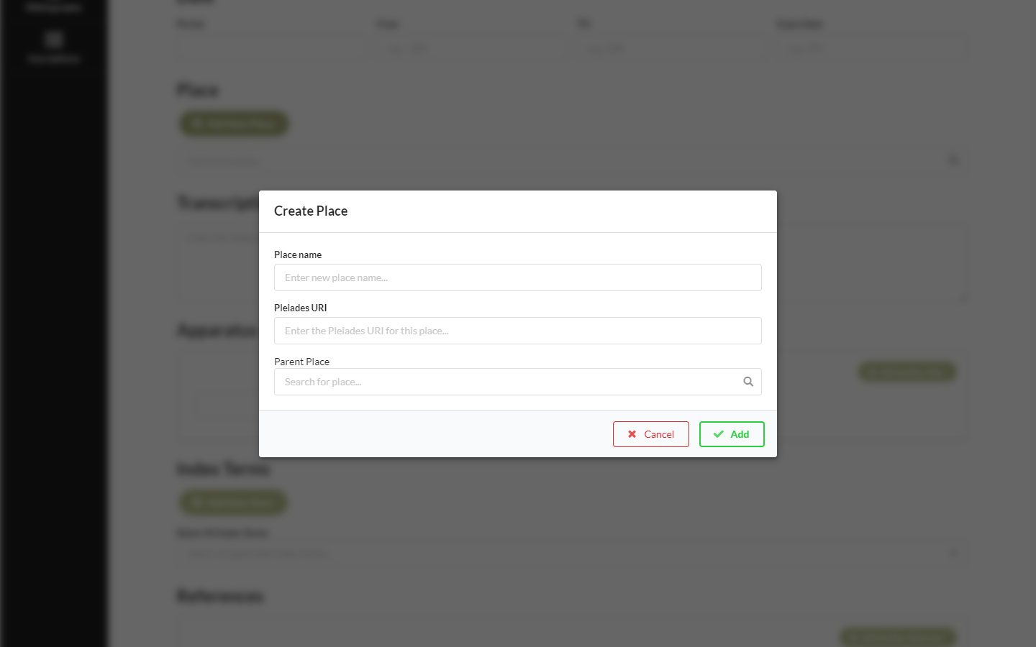
Editing environment (create place, index term)

Slide 24
Editing environment
https://data.brill.com/sites/segadmin/
site
https://github.com/BrillPublishers/SEGAdmin/wiki
wiki
https://github.com/BrillPublishers/SEGAdmin-UI
code

Slide 25
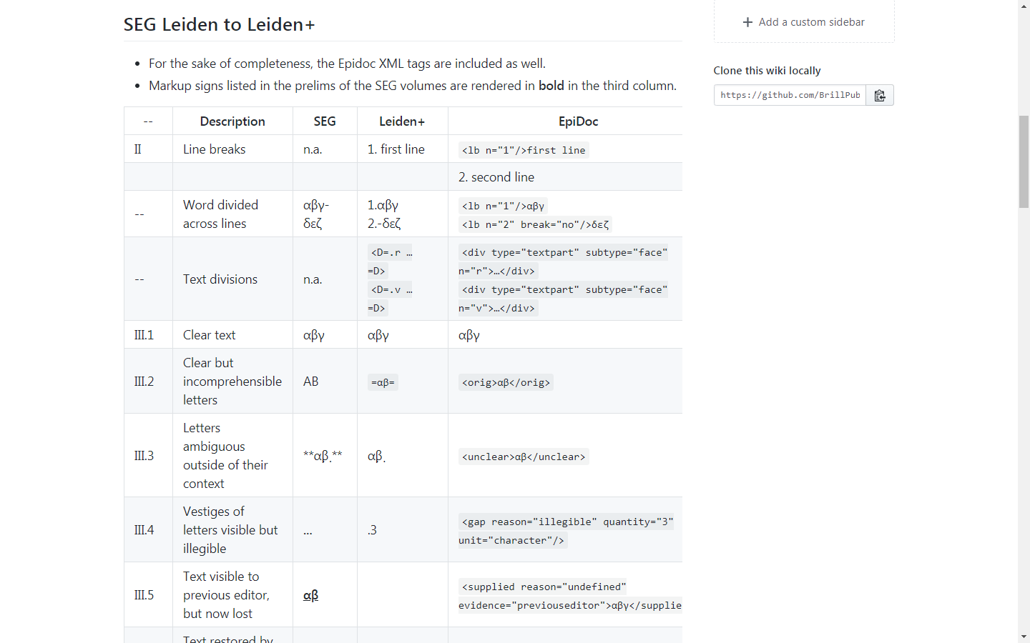
From Leiden to Leiden+

Slide 26
Project status
Finish interface (round 1)
Next step
Create print
Step 2
Create online
Step 3
Further development
?
Notes:
Note that other tools are possible, too, such as scripts or fonts…

Slide 27
Further work: Brill Epichoric font

Slide 28
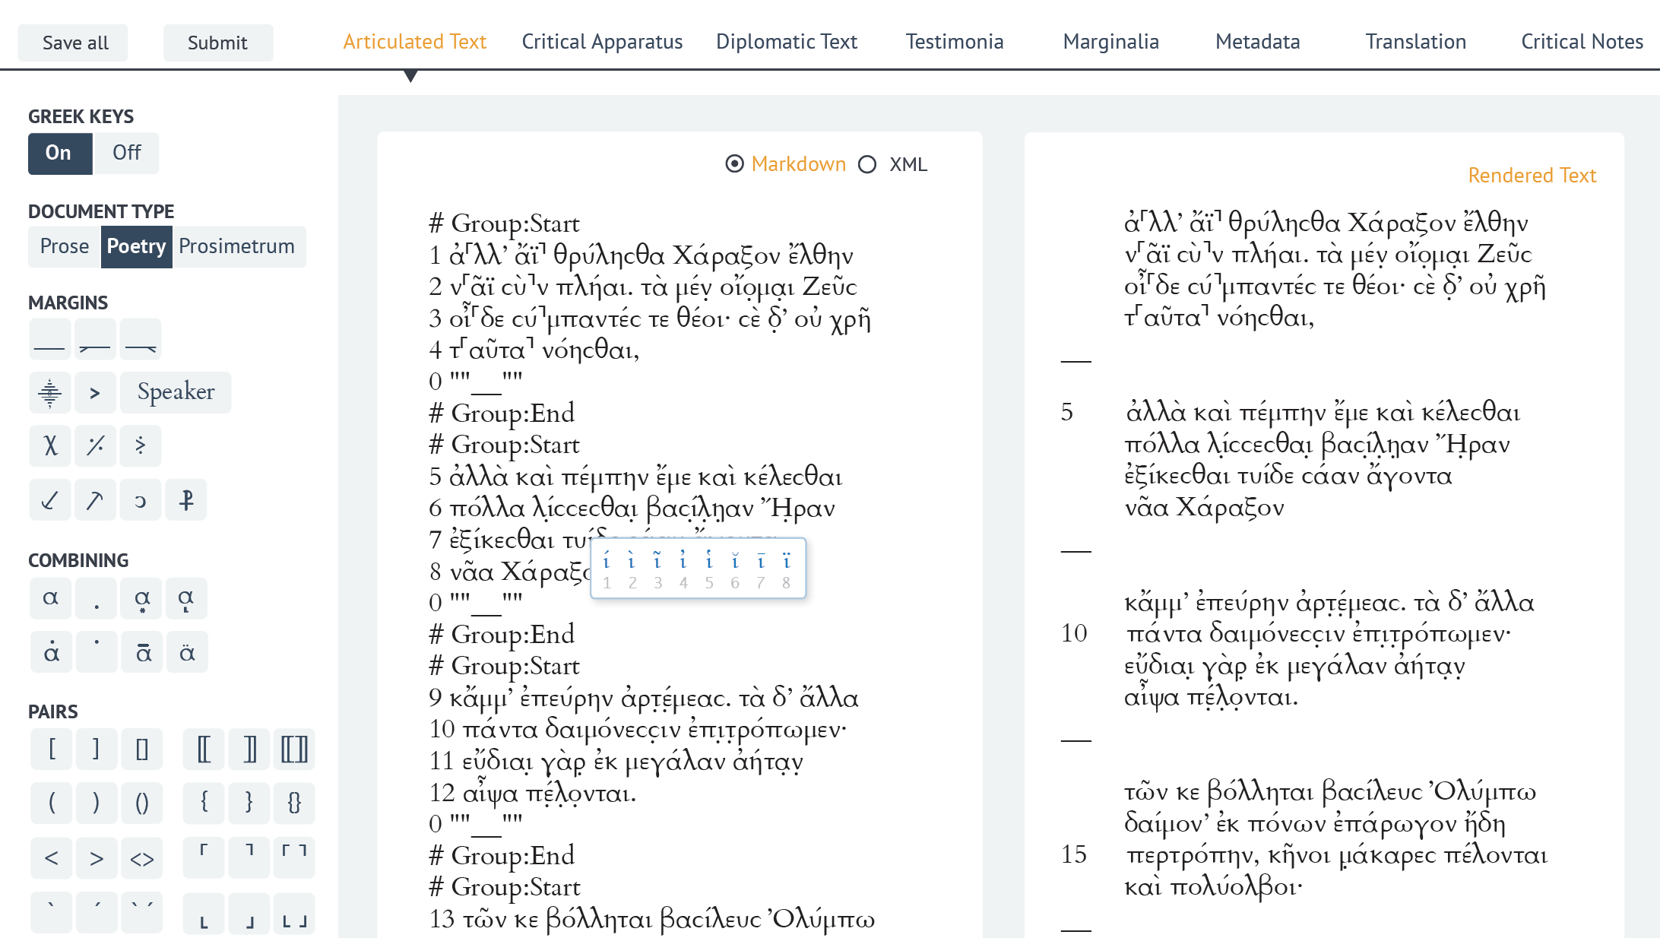
Further work: editor?
Notes:
This screenshot from the Proteus project (http://www.papyrology.ox.ac.uk/ProteusProject/) is inspirational. It shows how we could extend the editor, if the human editors want it…

Slide 29
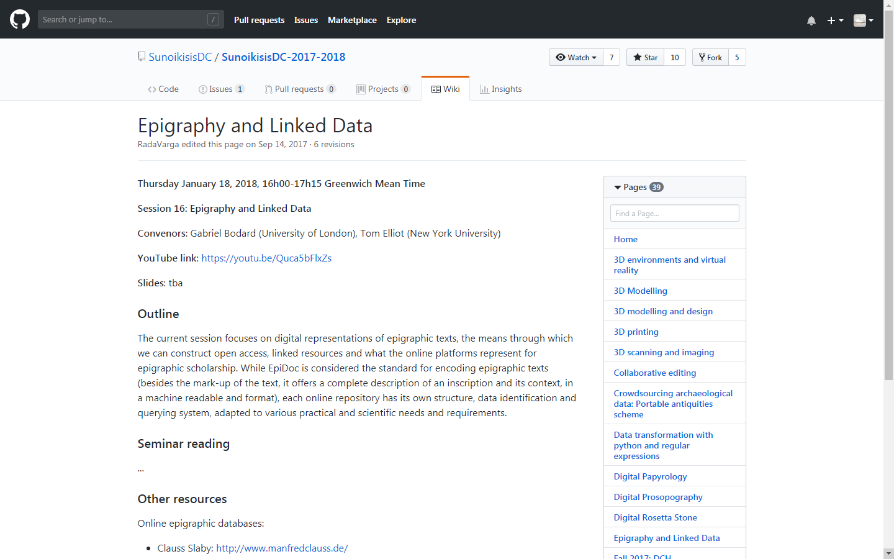
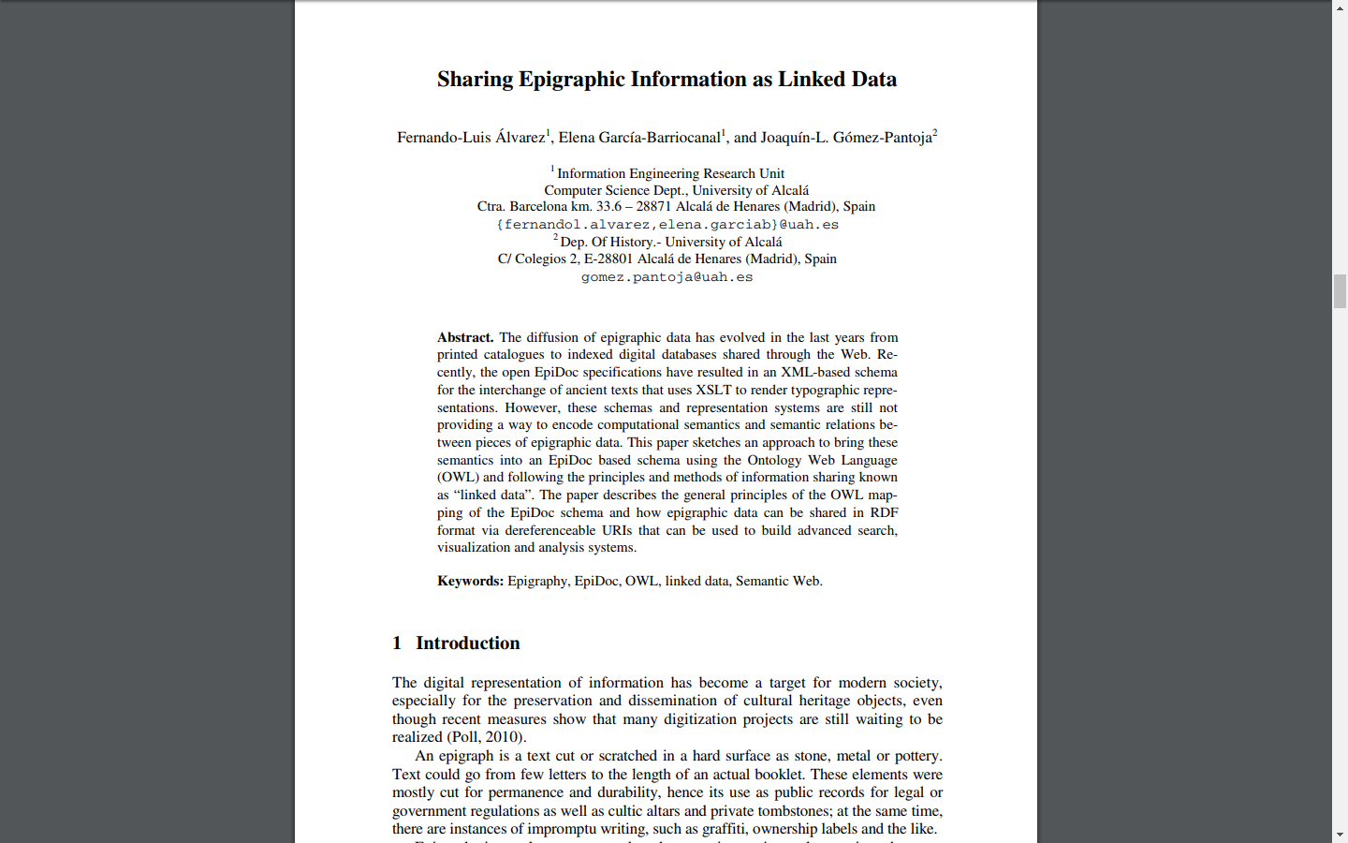
Further work: Linked open data
Notes:
Note that the aim is to create Linked Open Data output (as N-triples or JSON-LD) for each entry. To share and link with others.

Slide 30
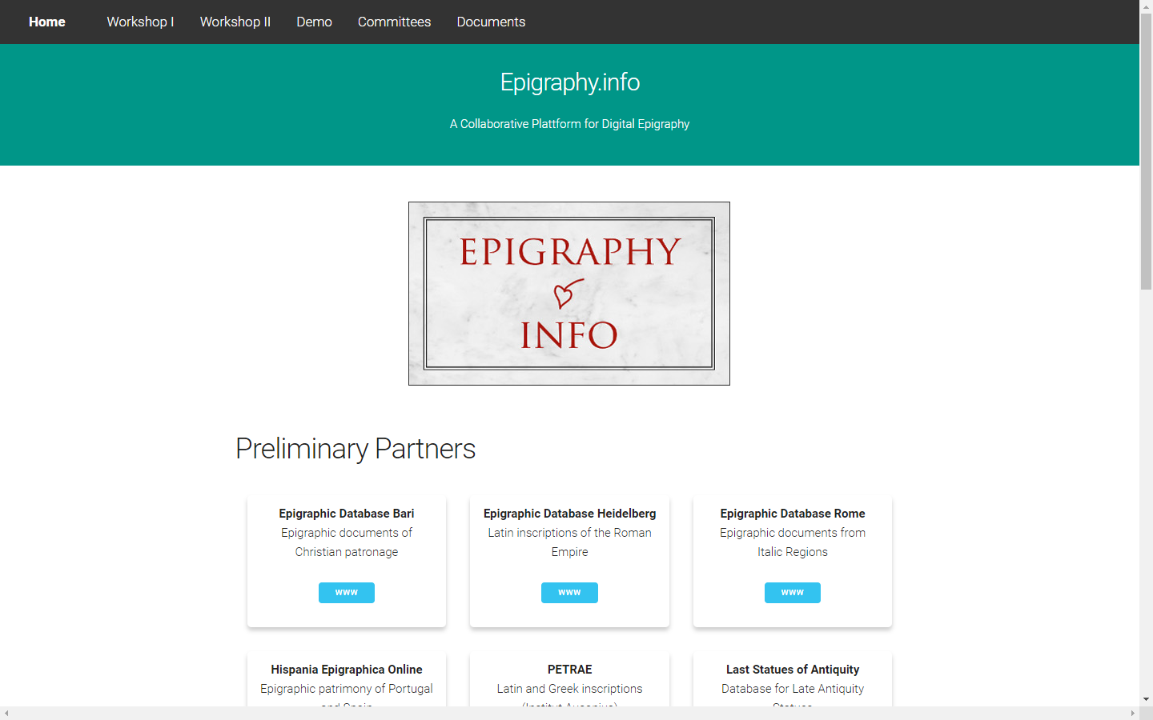
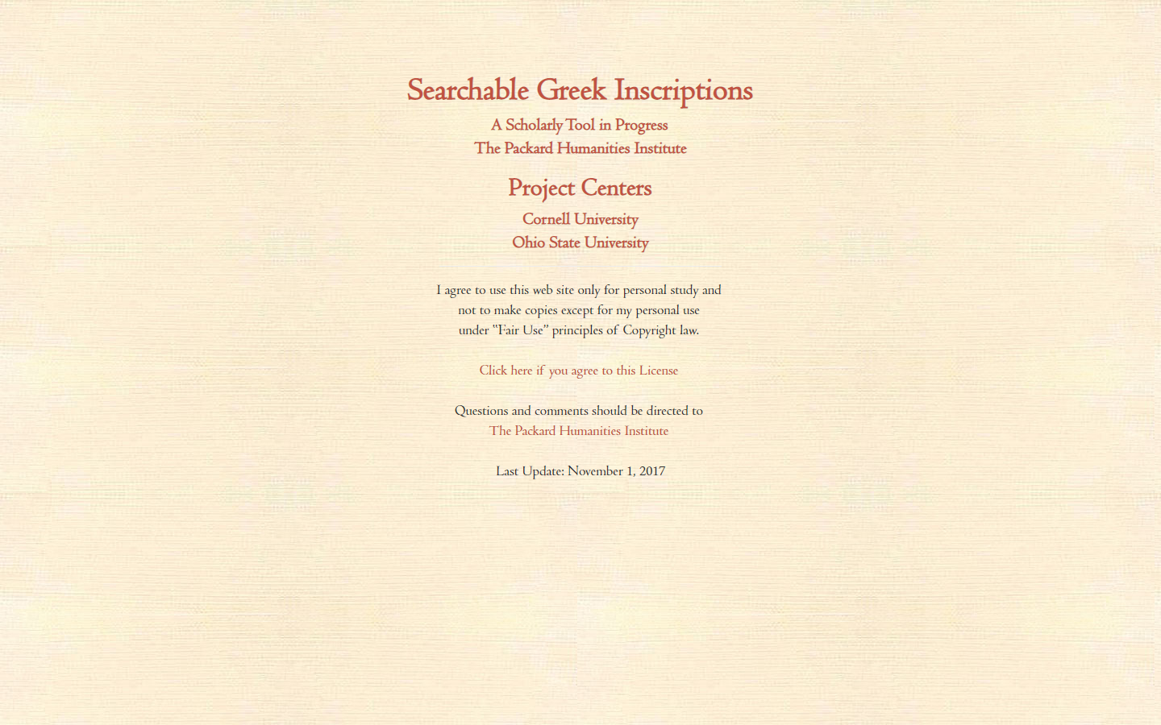
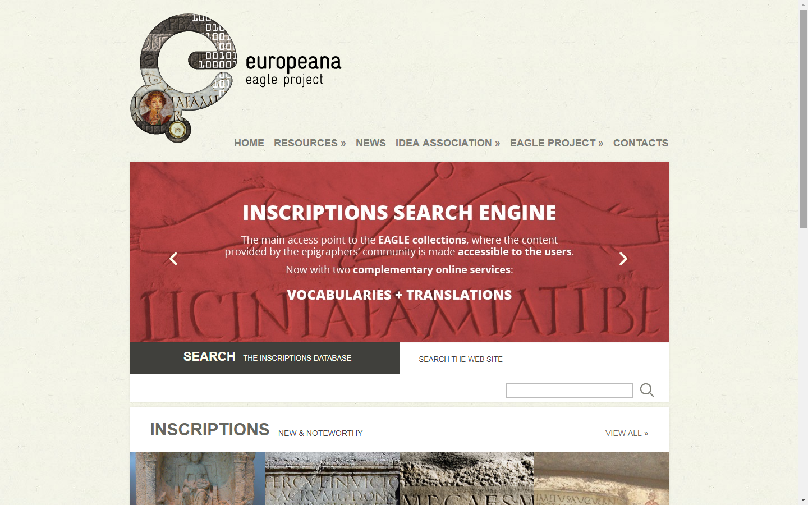
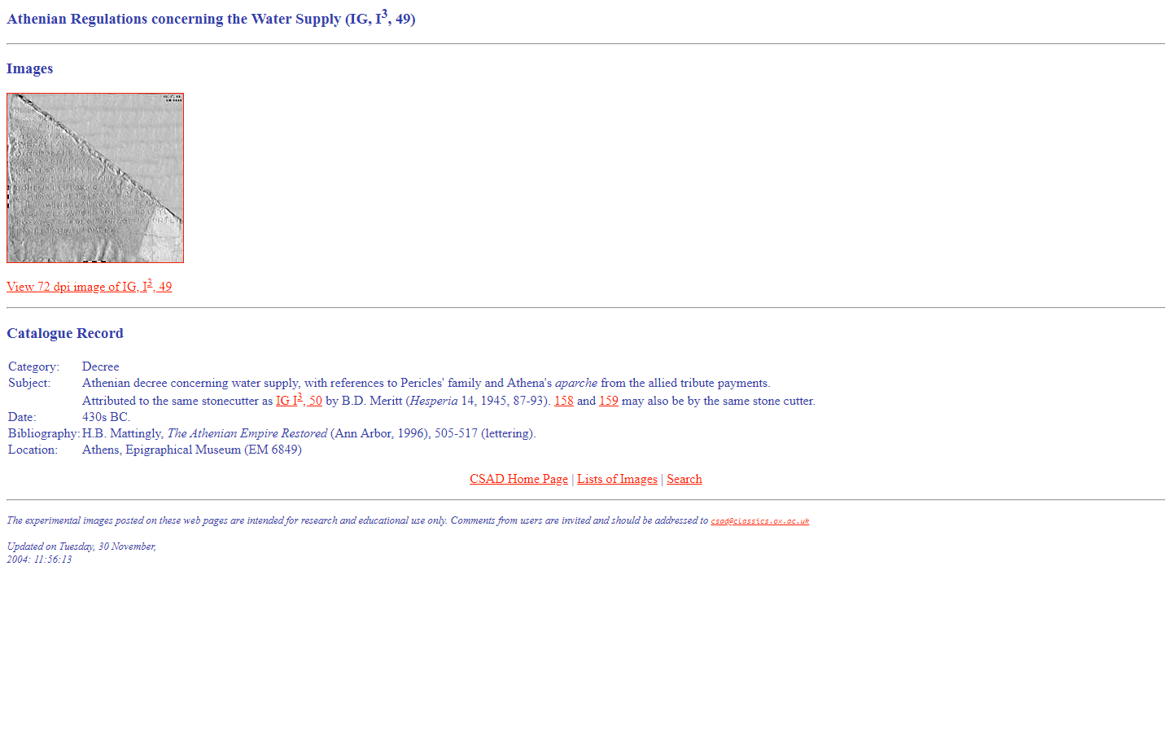
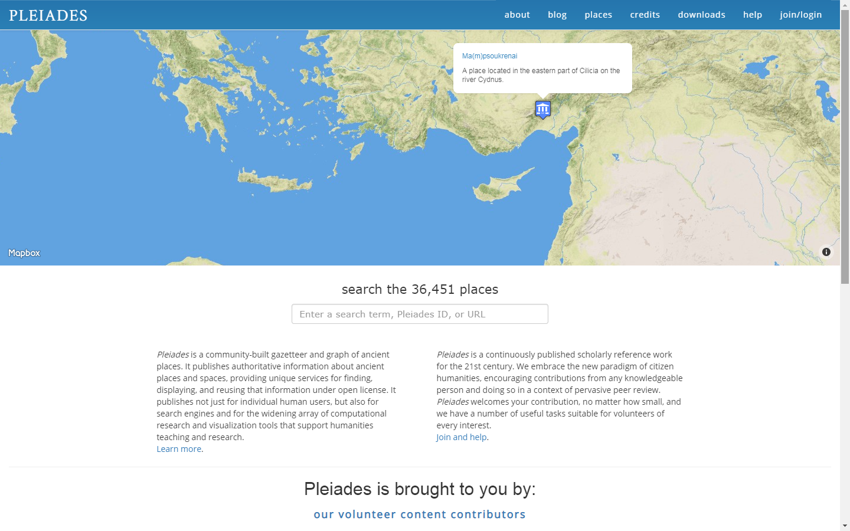
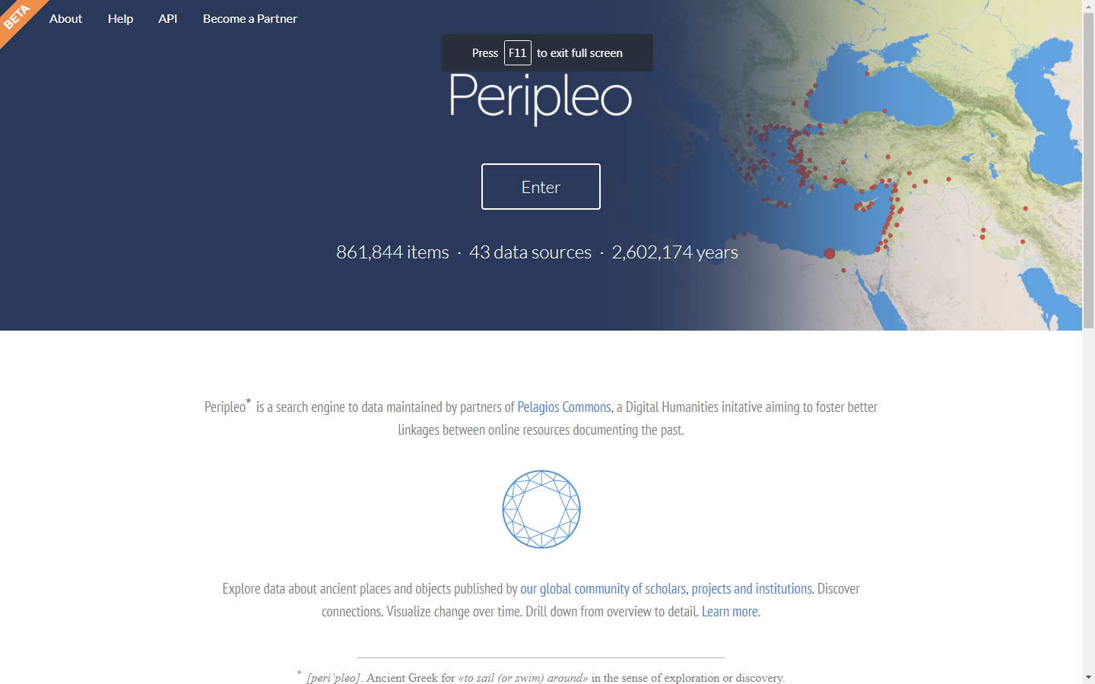
Further work: ?

Slide 31

Publication environment (print)
BSGRE 11
Notes:
Note that this is an example of an epigraphical work typeset according to the BTS. For SEG, a Django template will create a PDF.

Slide 32
Workflow for text editions
Author environment
Editing environment
Publication Environment
Writing
Editing
Data creation
Copy editing
Indexing
Data enrichment
Version management
Quality control
Search, browse
Read, analyze
Exchange, download
Print: TeX templates incorporating the Brill Typographical Style
Online: TEI (or Epidoc) XML
Any other data format
Plain text
MS Word Zotero, TeX, CTE
Notes:
Note that the SEG editing environment really spans the author environment and the editing environment.

Slide 33
Workflow for non-CMS Brill MRWs
.docx
.md
.xml
Python scripts are used to convert from one format to another
GIT takes care of version management
.pdf
print
Notes:
Note that, really, on the right side it should read: any format required by a publication environment. This includes data fed through APIs.

Slide 34
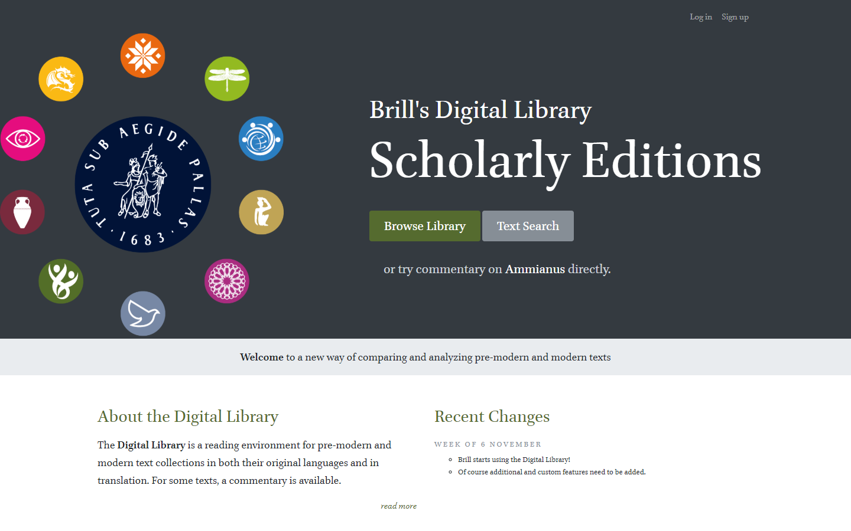
Publication environment (tour)
Notes:
Note that the Scaife Viewer supports Epidoc. Of course, we need to tweak things to support SEG (see below). Has anyone seen an interface created with the EpiDoc Front-End Services (EFES) yet?

Slide 35
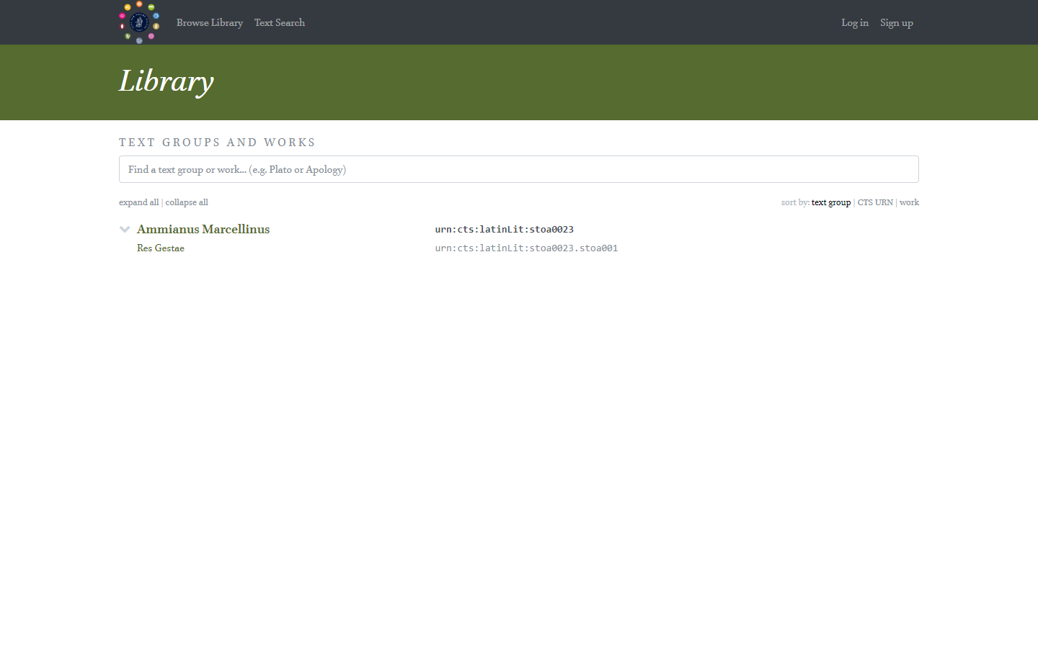
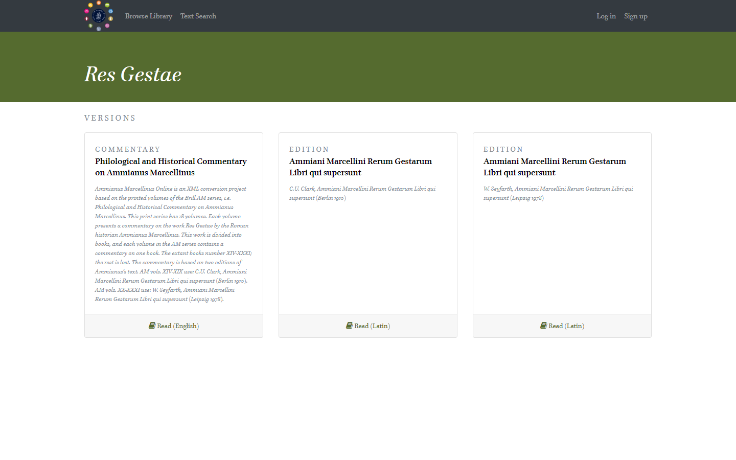
Publication environment (library)

Slide 36
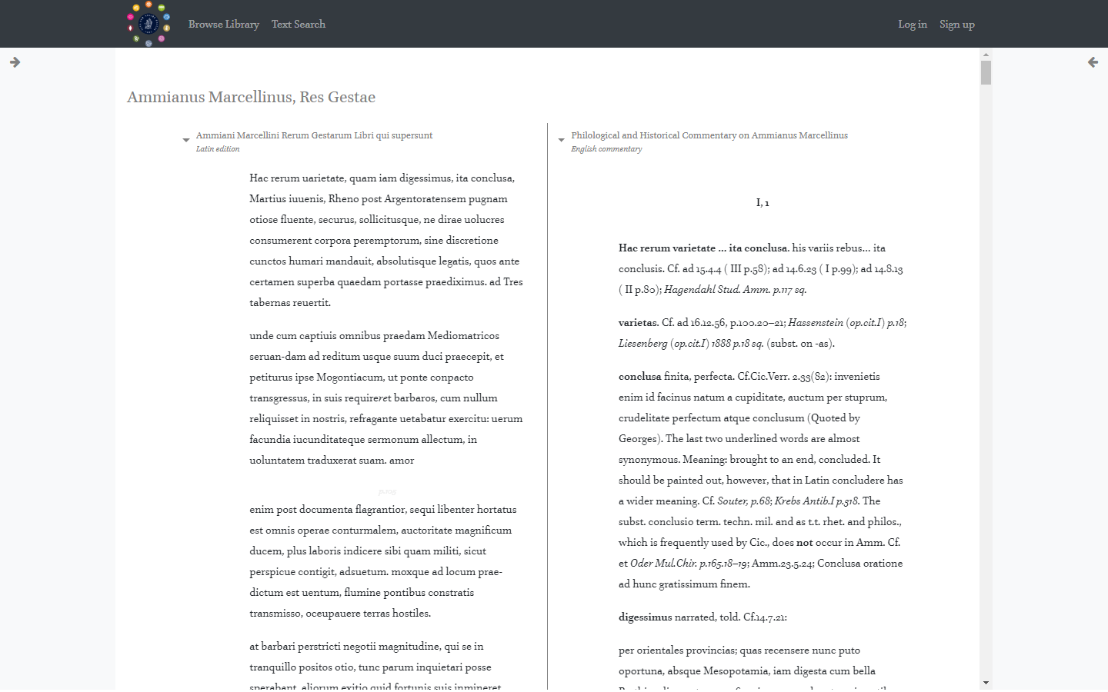
Publication environment (edition and commentary)

Slide 37
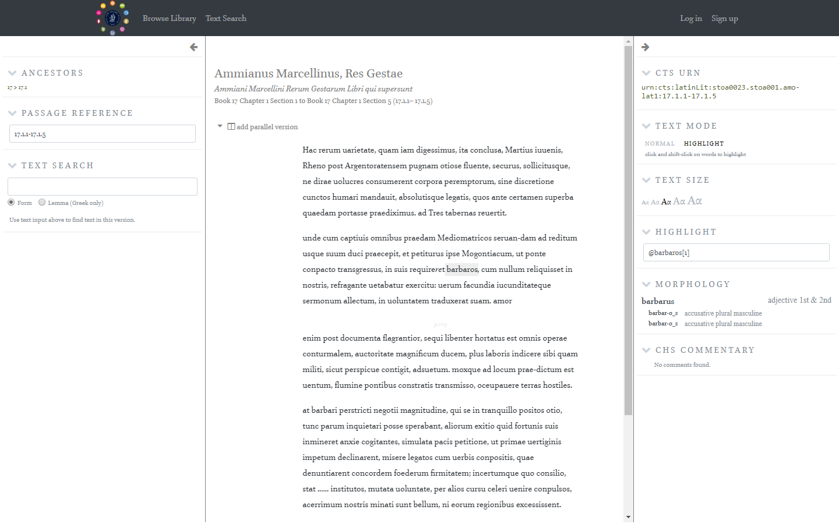
Publication environment (search, browse, tools)

Slide 38
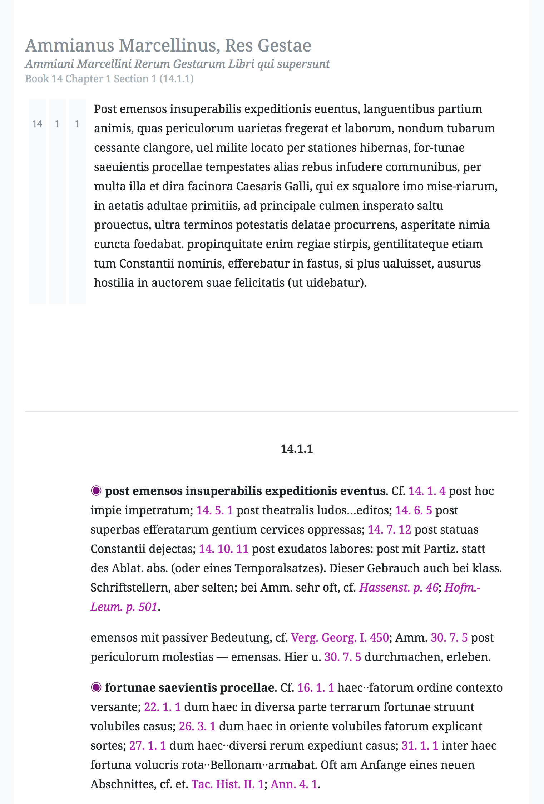
Publication environment (horizontal view)

Slide 39
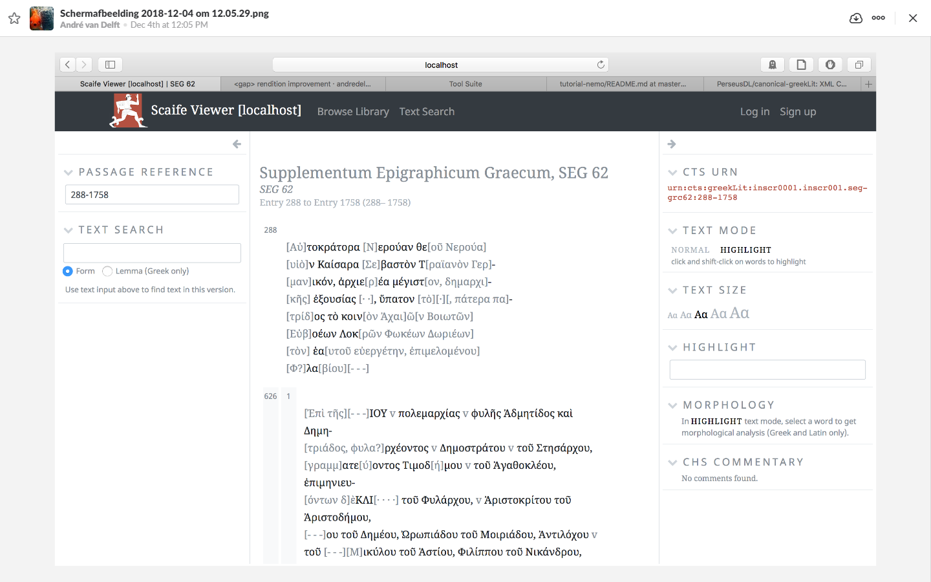
Publication environment (SEG)
Notes:
Note that we were thinking of creating three collections (CITE), which would be roughly equivalent to textgroups (CTS). To wit: inscriptions, entries, references. Each could be displayed in a panel. Widgets would take care of SEG-specific search and browse (data visualizations).

Slide 40
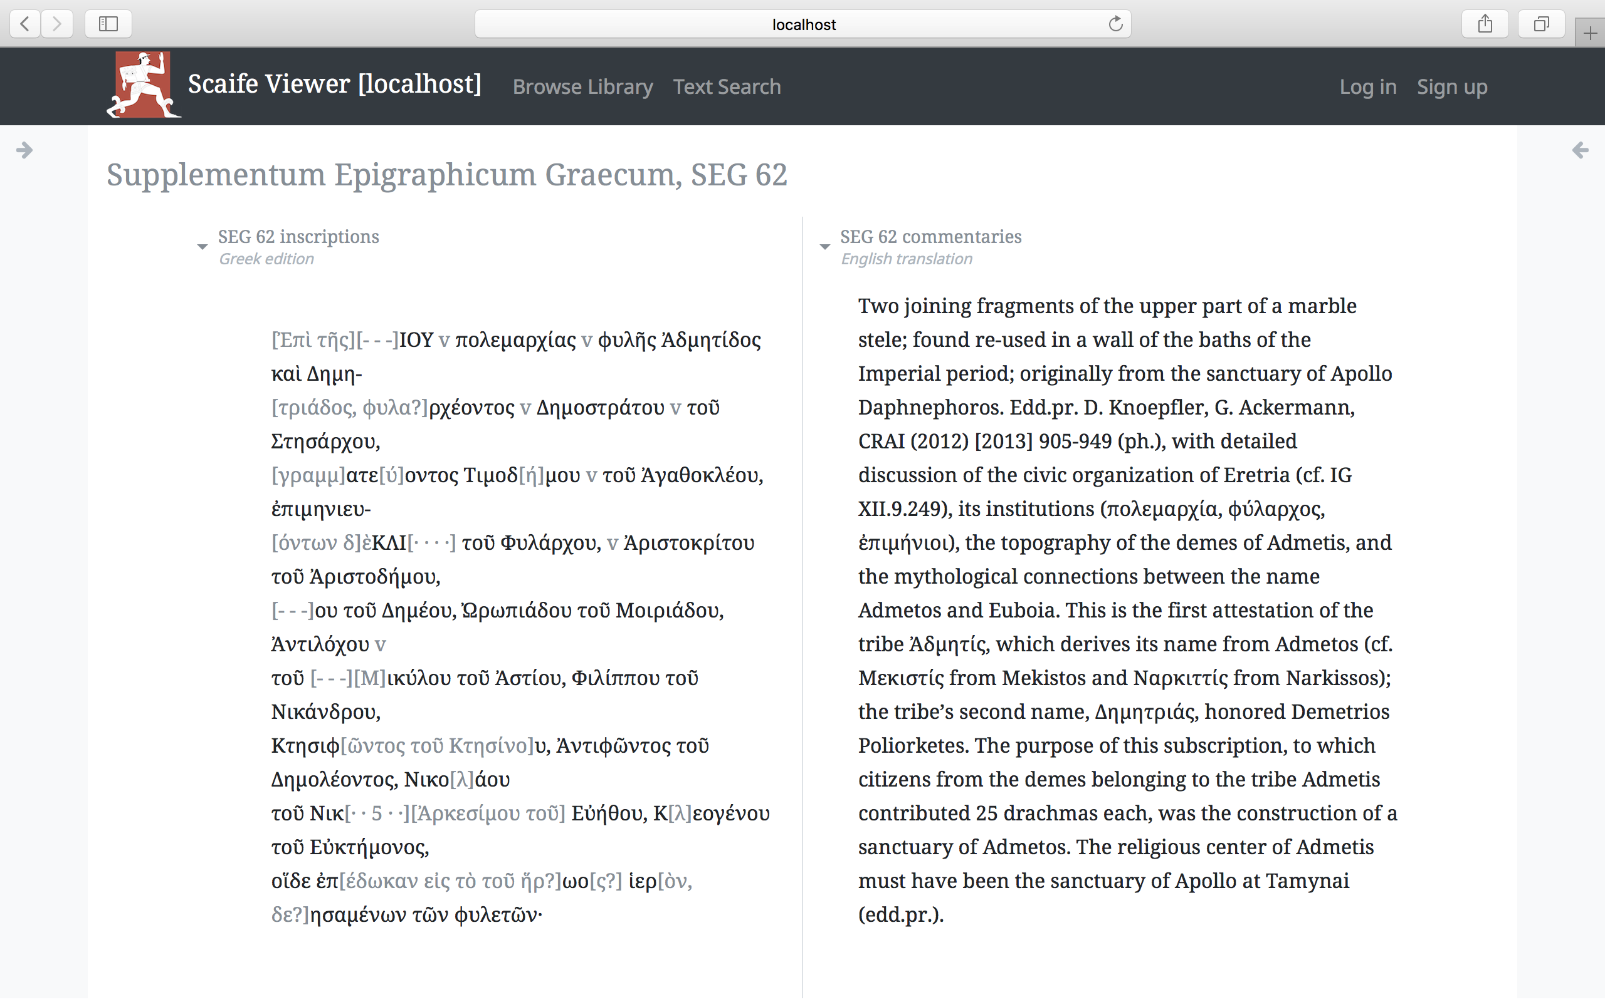
Publication environment (SEG, vertical view)

Slide 41
Publication environment
https://labs.brill.com/
site
Doesn’t exist… yet?
wiki
https://github.com/BrillPublishers/scaife-viewer
code

Slide 42
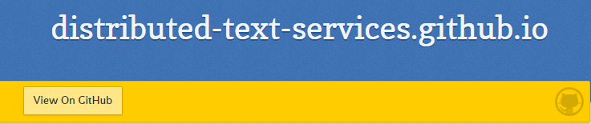
Questions (1)
CTS
Entry: urn:cts:brill:seg.entries.62626
Inscription: urn:cts:brill:seg.inscriptions.iseg62626
Reference: urn:cts:brill:seg.references.ref626261
CITE
or
Entry: urn:cite2:brill:seg:62626
Inscription: urn:cite2:brill:inscr:iseg62626
Reference: urn:cite2:brill:refs:ref626261
or
DTS

Slide 43
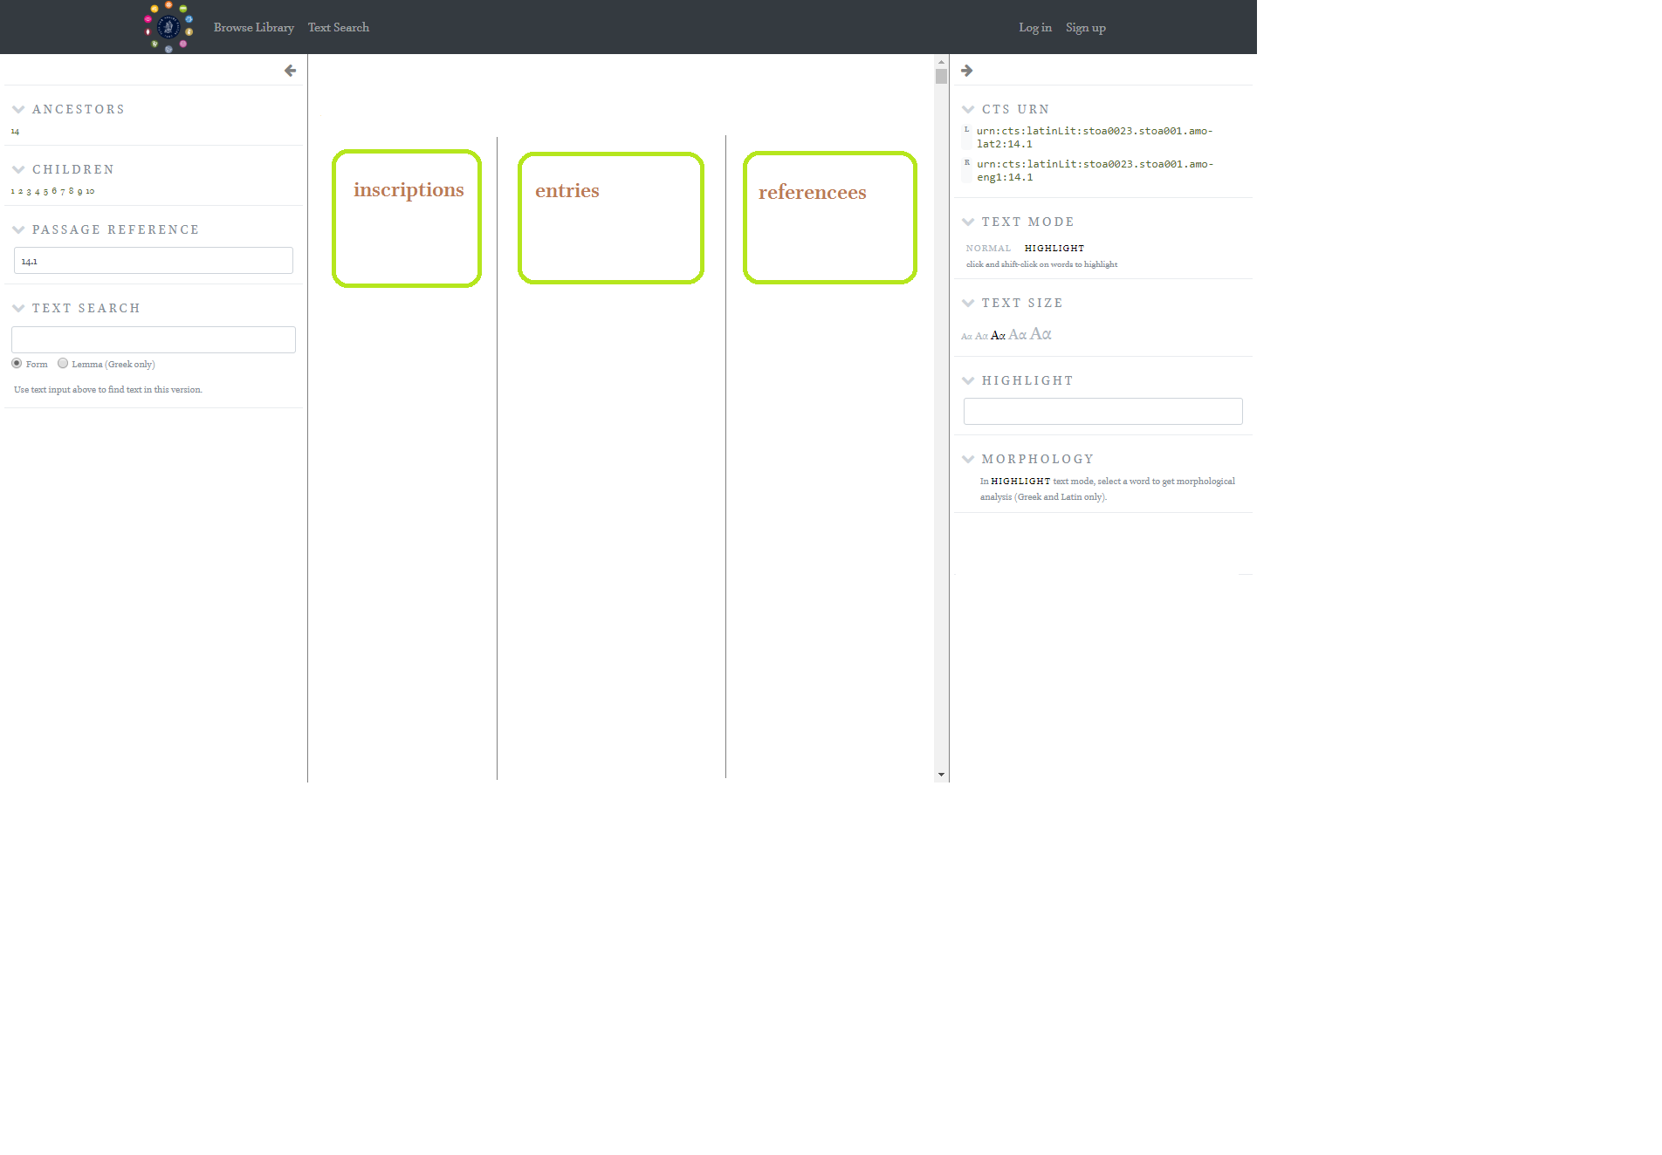
Questions (2)
Is this a good idea?

Slide 44
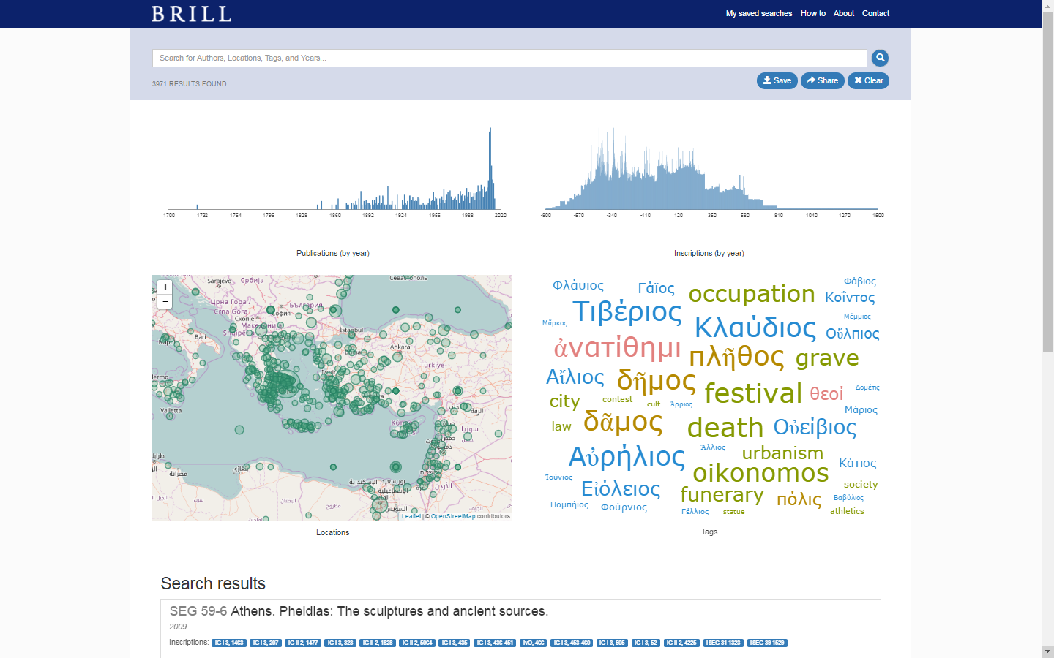
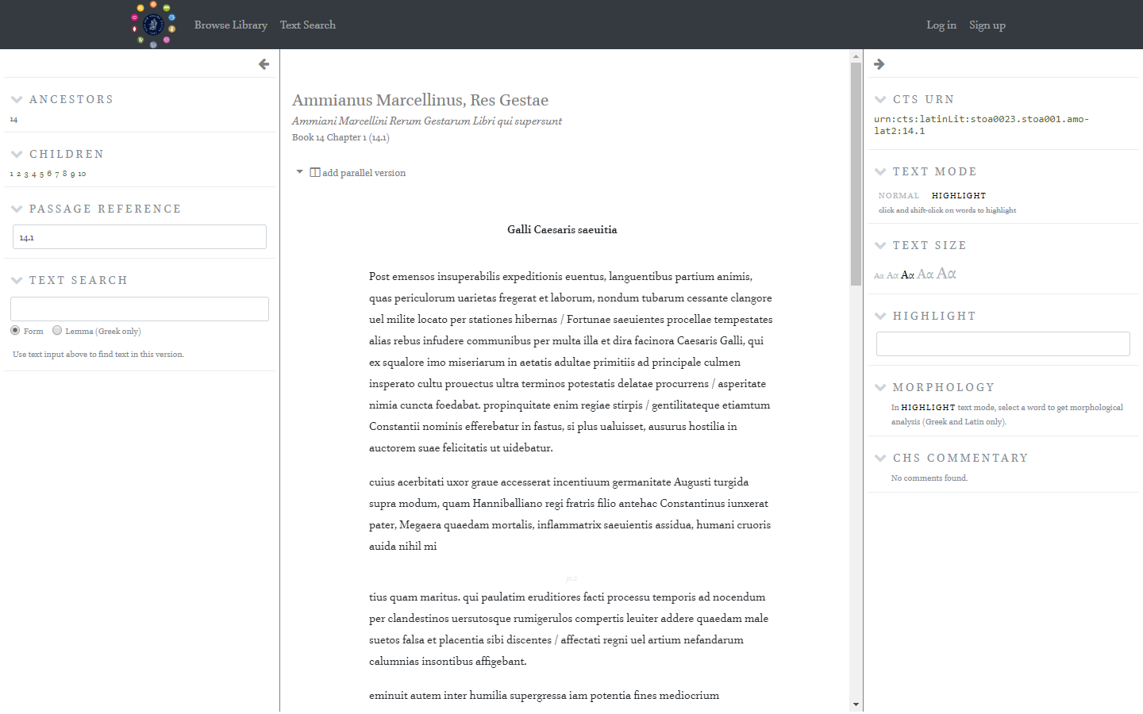
Questions (3)
What widgets?

Slide 45
Lessons learned
Data cleaning
More work than you think…
Fast communication
Proactive
Keep it simple
Kill your darlings
It always takes longer than you hope
Inevitable

